Slide 1
Buckland Green Streets
An Innovative Stormwater Management Project
in the village of Shelburne Falls in Buckland, MA.
Funding for the project comes from a MADEP 604b grant

Slide 2
Sustainable Stormwater Management (Low Impact Development)
Landscape-based approach to sustainable development, redevelopment, and retrofits
Strategies that maintain existing natural systems, hydrology, ecology
Strategies that protect natural resources
Cost-effective, flexible approach based on simple techniques
Implemented nationwide, in cold climates, urban areas, suburban areas, small towns
Conventional Storm Sewers (grey infrastructure)
Increased runoff & decreased recharge
Polluted waterways
Take up more space
Lack vegetation and wildlife habitat
Do not reflect community character
Expensive
Notes:
LID
LID is often described as a form of stormwater management Encompasses a set of techniques. cost-competitive with conventional approaches
*uses stormwater to minimize the impact of development on the landscape; to maintain existing natural systems; beginning with good site design. implemented nationwide, in cold climates, urban areas, suburban areas, small towns, etc.
Development is integrated with the landscape and hydrologic function, not imposed on top of it. Especially important in new construction (increasingly required in Town bylaws and regulations). Also possible for retrofits – as in this case.
Standard development techniques have very large impacts on the natural landscape and on natural systems, including hydrology and ecology; and can be out of step with the local character in Massachusetts communities.

Slide 3
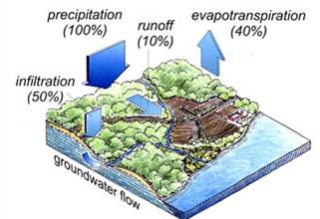
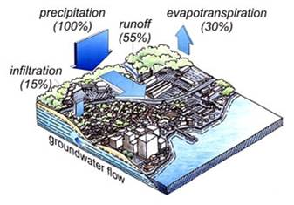
Rainfall and Stormwater Runoff vs. Infiltration
Undeveloped
Stormwater runoff = 10%
Rainfall Infiltration = 50%
Developed
Stormwater runoff = 55%
Rainfall Infiltration = 15%
Notes:
Non-point source pollution—that is, stormwater and all the contaminants in it—is now considered the leading cause of impaired waterways in Massachusetts. We’ve largely dealt with the pollution from sewage treatment plants and factories, but still the runoff from roads, parking lots, and lawns carries oil, sediment, nutrients, and other pollutants into rivers and streams. More and more communities are finding that the standard approaches to stormwater—put it in a pipe and send it to a detention pond—are very expensive and they are not doing enough to protect water quality.

Slide 4
Rainfall, Stormwater, and Peak Runoff Rates
0 4 8 12 16
Notes:
LID techniques result in lower peak discharge rates and reduced runoff volume as compared to most conventional approaches.
This graph compares the rate of stormwater runoff under two different scenarios. The purple at the bottom is a measurement of rainfall, and the yellow peaks show the rate of stormwater runoff under a conventional development scenario. You can see that small peaks in the rate of rainfall generate huge spikes in the rate of runoff; it is during these periods that the majority of stream erosion occurs.
Runoff from the low impact scenario is shown in red, and you can see that the rate of runoff rises with the increase in rainfall, but you don’t get the spikes in discharge rates that really affect channel geometry and aquatic habitat.
Many engineers would note that it is possible to manage the peak discharge rates using traditional stormwater structures such as retention ponds, but the point of LID is to minimize the necessity for such ponds through careful site design and decentralized stormwater management, which tend to be more cost effective than the pipe and pond approach.

Slide 5
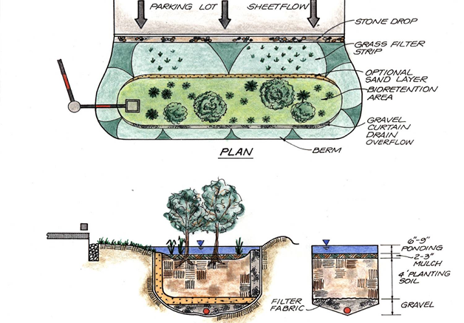
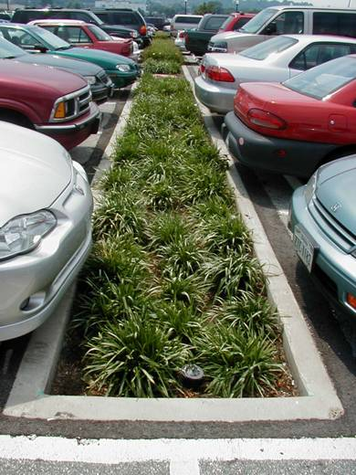
Treat stormwater close to the source
Manage frequent, low-intensity storms
Provide filtration, treatment, and infiltration
Provide open space and wildlife habitat
Store water for landscape use
Reduce heat island effect
Enhance site aesthetics
Notes:
small, decentralized techniques to treat stormwater runoff close to where it is created. many small LID structures. long flow paths and low slopes help to reduce runoff rates and increase groundwater infiltration.
Conventional stormwater systems treat stormwater at the “end of the pipe” in large detention ponds design to treat large volumes of runoff.
LID techniques are commonly designed in series; for example, runoff might flow over a filter strip, into a vegetated swale, which leads to a bioretention cell. This “treatment train” approach provides excellent stormwater management because each of the techniques helps to remove pollutants, allow infiltration, and slow down the runoff to reduce peak discharge rates.
LID techniques are excellent strategies for controlling peak discharge rates from frequent, low-intensity storms, and they can usually be sized to accommodate the entire “water quality volume”—the first inch or half-inch that must be treated according to the Massachusetts Stormwater Policy. However, on sites with large amounts of impervious surfaces, it is likely that additional controls may be needed to manage the runoff from very large storms, such as the 25-year or 100-year storm. With LID, these controls will be considerably smaller than they would be otherwise.

Slide 6
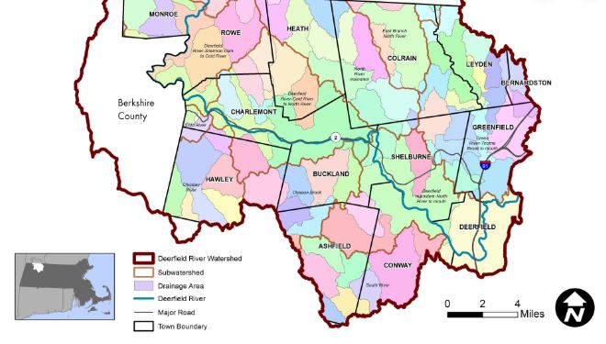
Water Quality & Resilience in the Deerfield River Watershed
Mitigate stormwater and flash flooding
Protect soil, vegetation, and wildlife habitat
Protect infrastructure and public safety
Reduce non-point source pollution
Respect community character

Slide 7
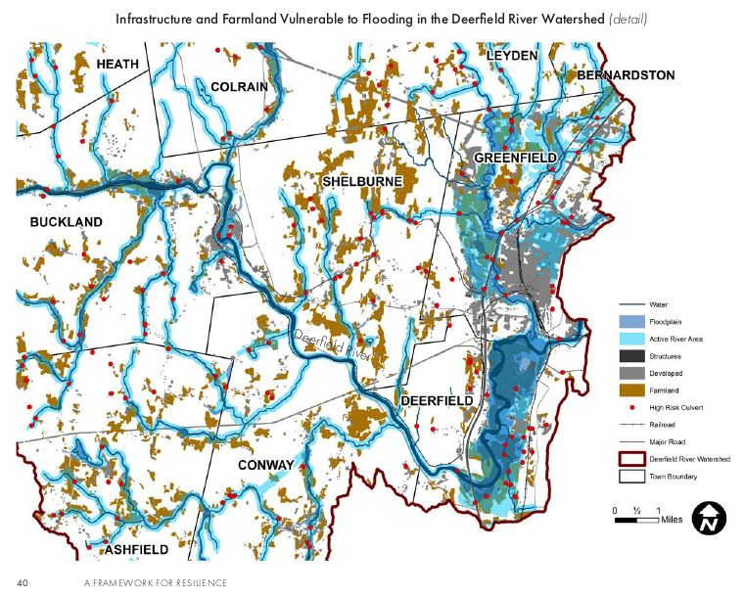
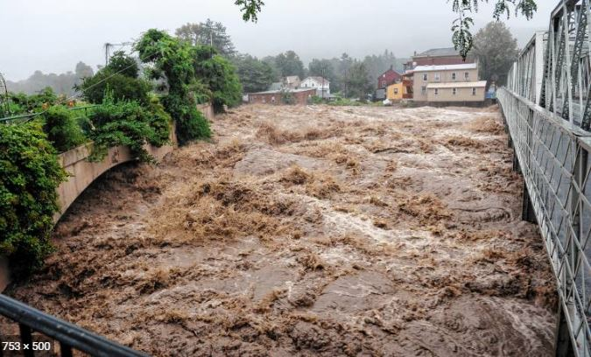
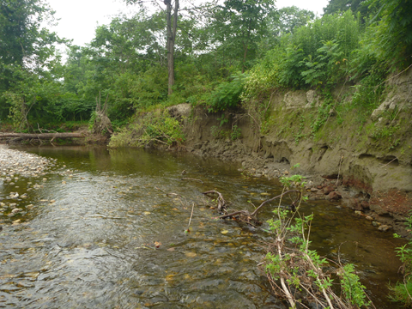

Slide 8
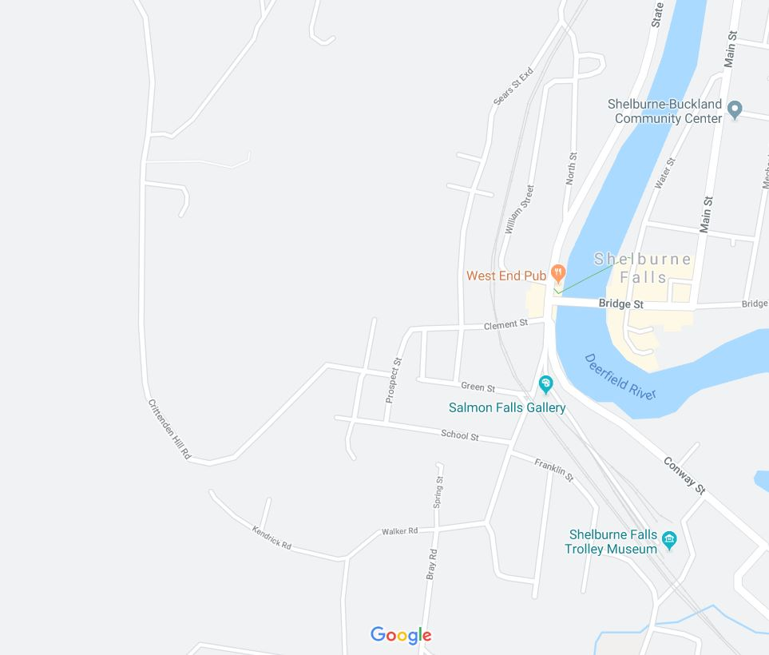
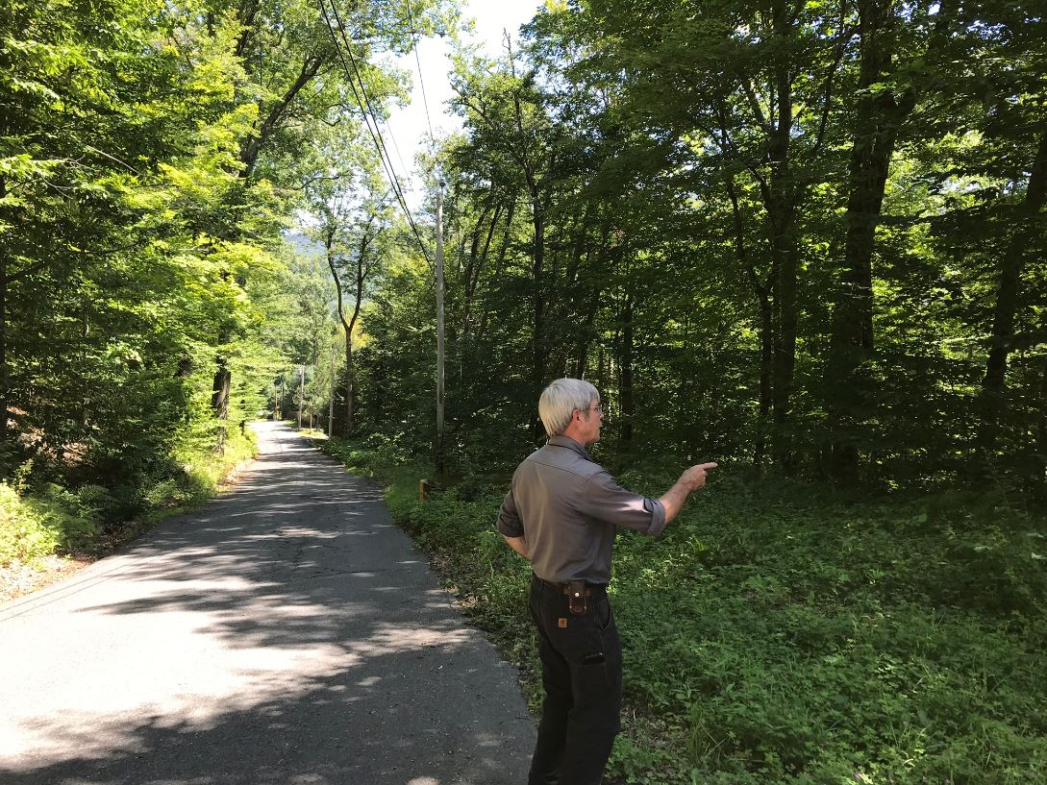
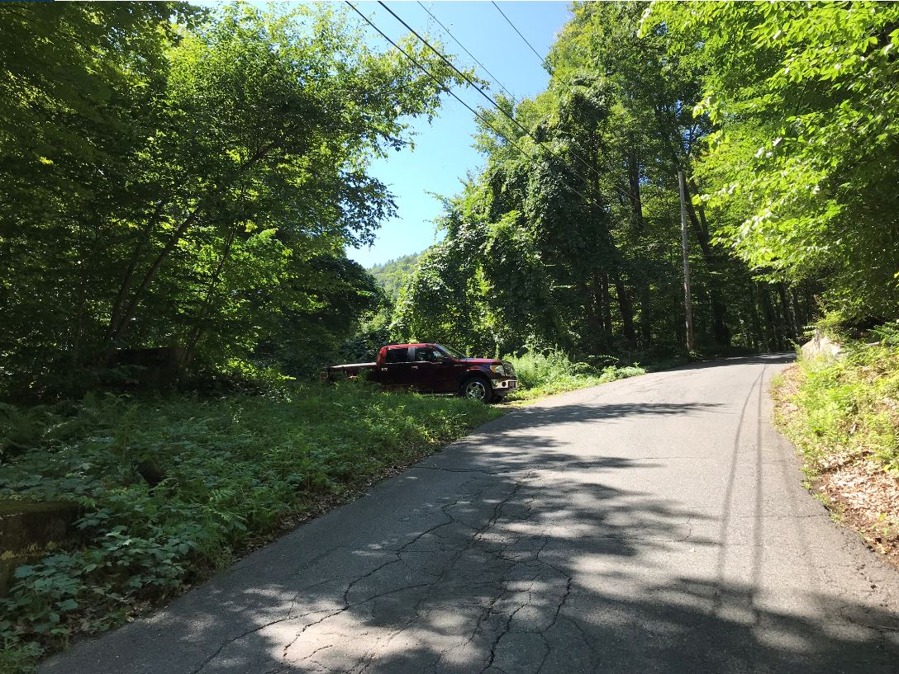
Crittenden Hill Road, Buckland, MA.

Slide 9
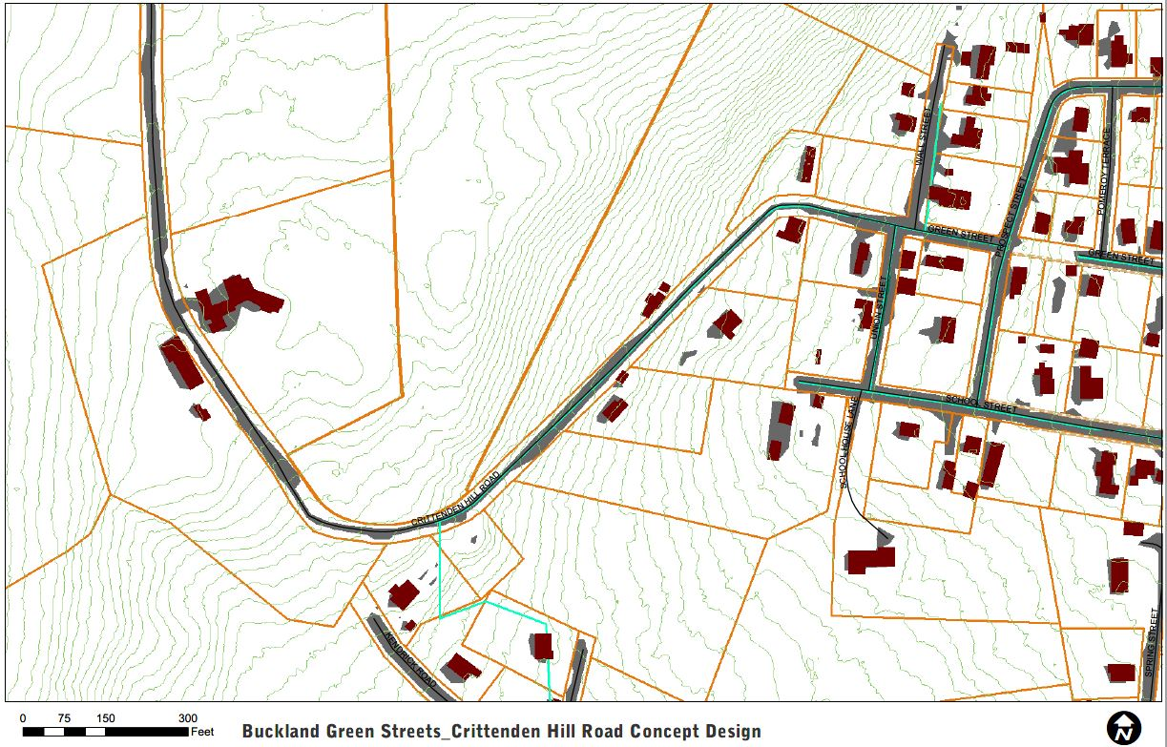
Crittenden Hill Road Stormwater Management Concept Design
STORMWATER
Notes:
Site 5
9 total sites were assessed in the village and this site was selected for having the best potential
Desktop assessment
Town road intercepts <30+ acre drainage area off of Goodnow Hill. Large volumes of stormwater runoff
STEEP: 8-15% slopes
Mountain stream
Existing unused concrete water tank
Catchbasins at bottom of hill are the beginning of storm sewer draining to Deerfield River

Slide 10
Crittenden Hill Road Stormwater Management Concept Design
Roadwork and Infrastructure Upgrades
Possible regrading, widening, and curbing of the existing road
New catchbasins and storm sewer piping to safeguard homes downslope from runoff
Culvert upgrade over mountain stream at base of hill.
New Bioretention Basin
Intercept and pretreat runoff at bottom of road
Receive overflow from water tank
Overflow to existing catch basins, which are the beginning of the storm sewer
New Bioretention Basins
Multiple connected basins possible
Intercept and pretreat runoff at top of road
Overflow to storm sewer
Water Tank Retrofitted to Bioretention Basin
30 ft. concrete water tank
Existing location and grade suitable to intercept stormwater from road and surrounding slopes
Overflows into new stormwater infrastructure in ROW needed to safeguard residential properties and address existing erosion and flash flooding hazards

